Slide 1

Module Thirteen: Misinformation, Disinformation, and cyber-warfare
CIS 303 – Prof. C. R. Johnson

Slide 2
Data sovereignty
Data sovereignty refers to a government's control over the data that is generated and collected within a country. The issue of data sovereignty was heightened when Edward Snowden leaked US government information about a number of governments and individuals whom the US government was spying on. This prompted many governments to reconsider their approach to data sovereignty and the security of their citizens' data.
The restriction of data flow can hinder scientific discovery, to the disadvantage of many but particularly, developing countries. This is of considerable concern to big data ethics because of the tension between the two important issues of cybersecurity and global development.

Slide 3
Notable concerns
Data brokers in the United States include Acxiom, Experian, Epsilon, CoreLogic, Datalogix, Intelius, PeekYou, Exactis, and Recorded Future.
Acxiom claims to have files on 2.5 billion people, with about 11,000 data points per consumer. The company Oracle has publicly noted it has connections with 80 data broker companies.
The US Department of Homeland Security has purchased cell phone location data and home utility data from data brokers to facilitate deportations. The Federal Bureau of Investigation (FBI) has purchased personal data from the company Venntel. Under both of these circumstances, a warrant is not required to acquire this data, due to the fact that it is "open source" or "commercially obtained". Use of the data also has implications in background checks (used in rent/housing and job applications).

Slide 4
Notable Concerns
In 2017, Cambridge Analytica claimed that it has psychological profiles of 220 million United States citizens, based on 5,000 separate data sets, with another source reporting 230 million. A scandal emerged after it was found that after 270,000 Facebook users consented to sharing their data, data was scraped from about 50 million profiles on the social media platform. This was seen as breach of trust by Facebook.
In 2018, American companies spent $19 billion acquiring and analyzing consumer data, according to the Interactive Advertising Bureau.
In 2021, The Pillar outed a Catholic priest by purchasing data from a data broker including data usage from Grindr.

Slide 5
Notable Concerns
In fact, governments in general seem to be the actual consumers of most big data.
The Integrated Joint Operations Platform (IJOP, 一体化联合作战平台) is used by the government to monitor the population, particularly Uyghurs. Biometrics, including DNA samples, are gathered through a program of free physicals.
China has recent publicly revealed its social credit system, based on large dataset on citizens. The Social Credit System, now being piloted in a number of Chinese cities.

Slide 6
Notable Concerns
The biggest consumer of big data in the USA is likely the US Government, which we did not actually notice until the Snowden leak. Now we know the National Security Administration (NSA), which monitors the activities of the Internet constantly in search for potential patterns of suspicious or illegal activities their system may pick up.
2013 mass surveillance leak

Slide 7
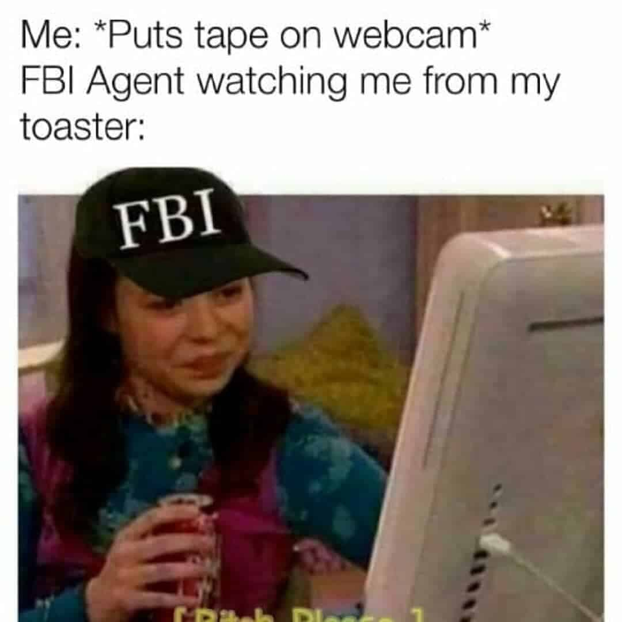
Snowden effect
“If you give up your privacy, you give up your power.” – Thor Benson.
Even if you’re not familiar with the leaks specifically, you have no doubt felt the effects. Or at least seen memes like these:

Slide 8
Snowden effect
Snowden revealed that the GCHQ had a whole list of Smurf tools, each with its own use and purpose. Here are some examples:
Dreamy Smurf – Has the ability to turn phones on or off remotely
Nosey Smurf – Has the ability to make use of the phone’s microphone to listen to conversations and noise in the local area.
Tracker Smurf – Has the ability to track your position precisely
Paranoid Smurf – Works to hide the activities of the other Smurfs to prevent detection

Slide 9
XKeyScore
“You could read anyone's email in the world, anybody you've got an email address for. Any website: You can watch traffic to and from it. Any computer that an individual sits at: You can watch it. Any laptop that you're tracking: you can follow it as it moves from place to place throughout the world. It's a one-stop-shop for access to the NSA's information. ... You can tag individuals ... Let's say you work at a major German corporation and I want access to that network, I can track your username on a website on a forum somewhere, I can track your real name, I can track associations with your friends and I can build what's called a fingerprint, which is network activity unique to you, which means anywhere you go in the world, anywhere you try to sort of hide your online presence, your identity.”

Slide 10
PRISM
PRISM was the code name given to an NSA program in which the agency could effectively demand data from major tech and internet companies like Google, Facebook, and Apple.
The sorts of content the NSA could collect included search histories, downloads, emails, and more. The focus of the program was to track potential terrorism suspects, but the system effectively allows for the data of almost any internet user to be taken, making it a huge threat to people’s privacy.

Slide 11
ANT Tools
SURLYSPAWN – Able to log keystrokes on a computer and transmit them wirelessly, even when the computer isn’t connected to the internet
CANDYGRAM – Able to imitate a GSM cell phone tower to monitor cell communications
FIREWALK – Designed to look just like a regular RJ45 internet socket, this tool can inject and monitor device data via radio waves
MONKEYCALENDAR – Able to transmit a cell phone’s geolocation via a secret text message
COTTONMOUTH – Designed to look like USB and Ethernet connectors, these tools can hack into computers and provide remote access

Slide 12
Big Data Tool
Boundless Informant (or BOUNDLESSINFORMANT) is the code name given to a big data analysis tool used by the NSA. This tool basically tracks all of the metadata collected by the NSA around the world and makes a kind of ‘heatmap’ of that data to show where it came from and which countries are targeted most frequently.
The tool showed that billions of pieces of information were being collected every single month, and it also showed that several billion pieces were being taken from citizens of the United States. This was despite the fact that the NSA had specifically stated to Congress that it did not gather data on millions of American citizens and didn’t even have the capacity to do so.

Slide 13
United States v. Moalin
An appeal by four Somali individuals who had been convicted based on data obtained through bulk telephone data collection by the National Security Agency. The appeals court upheld their convictions, but also ruled that bulk telephone data collection by the National Security Agency, the details of which were leaked by Edward Snowden, were illegal.
The case proceeded slowly because of classified data, taking seven years.
On September 2, 2020, a unanimous decision by the three-judge panel was published. They ruled that bulk collection of telephone data was illegal because it violated the Foreign Intelligence Surveillance Act. They also ruled that it was possibly unconstitutional.
However, this decision may not have had a major effect, because the bulk telephone data collection program involved in the case ended in 2015, and the program that replaced it was also shut down.

Slide 14
What is MISINFORMAION?
Misinformation: False or incorrect information
Purpose: Affect the perception of people
Notes:
Misinformation is false or incorrect information, it can be spread intentionally or unintentionally (without realizing it is untrue)

Slide 15
Problem Overview:
The large use of Online Social Networking has provided fertile soil for the emergence and fast spread of rumors.
It is difficult to determine all of the messages or posts on social media are truthful.
Fake news harms to real life.

Slide 16

Is This Real?
KFC Donut Chicken Sandwich

Slide 17
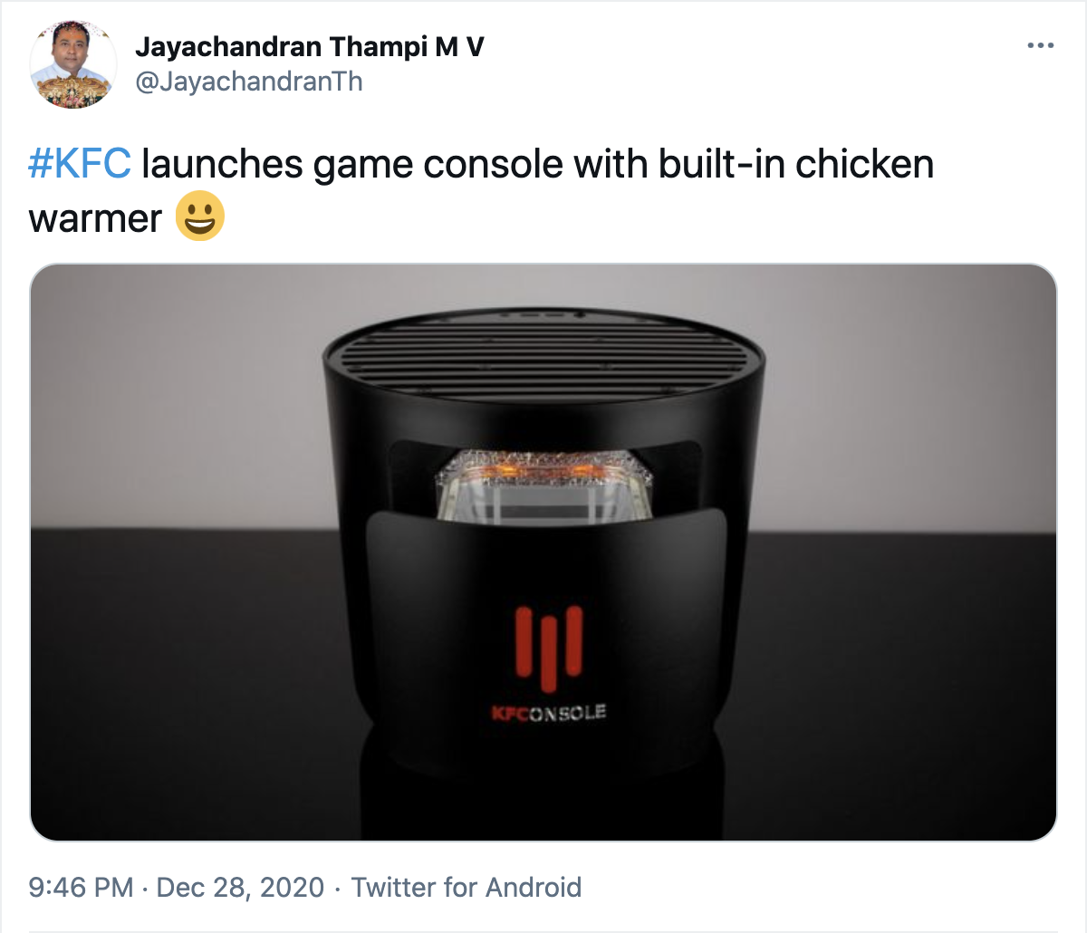
Is This Real?
Console Chicken Warmer

Slide 18

Fact Check

Slide 19
What is ‘information pollution’
Many kinds of low-quality, false and misleading information circulate online
This is called ‘information pollution’
We need to figure out where information is coming from and whether it is real or truthful

Slide 20
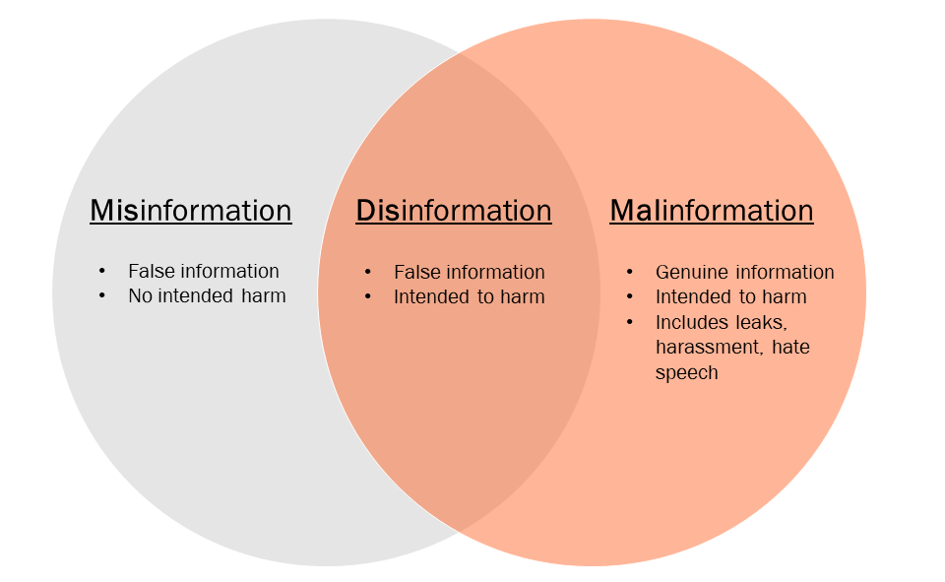

Slide 21
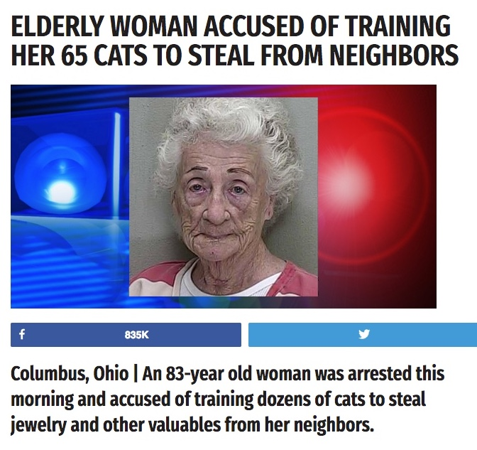
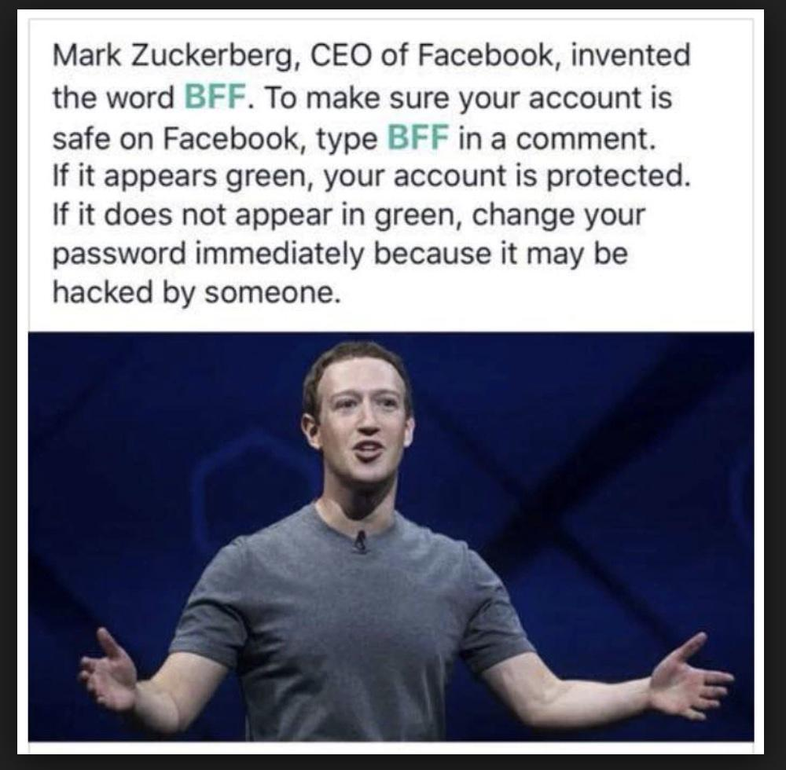
Misinformation

Slide 22
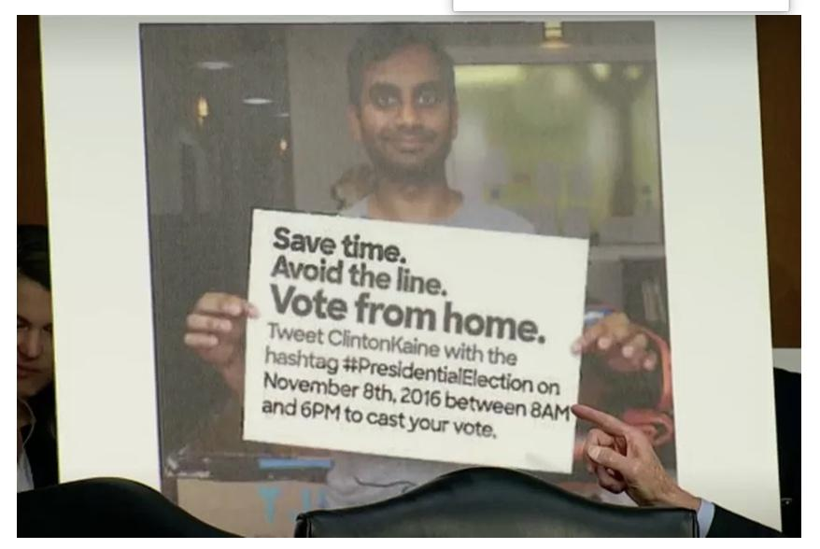
Disinformation
False information can be designed to mislead and achieve a political goal.
For example, telling people they can vote through Twitter, when they cannot.

Slide 23
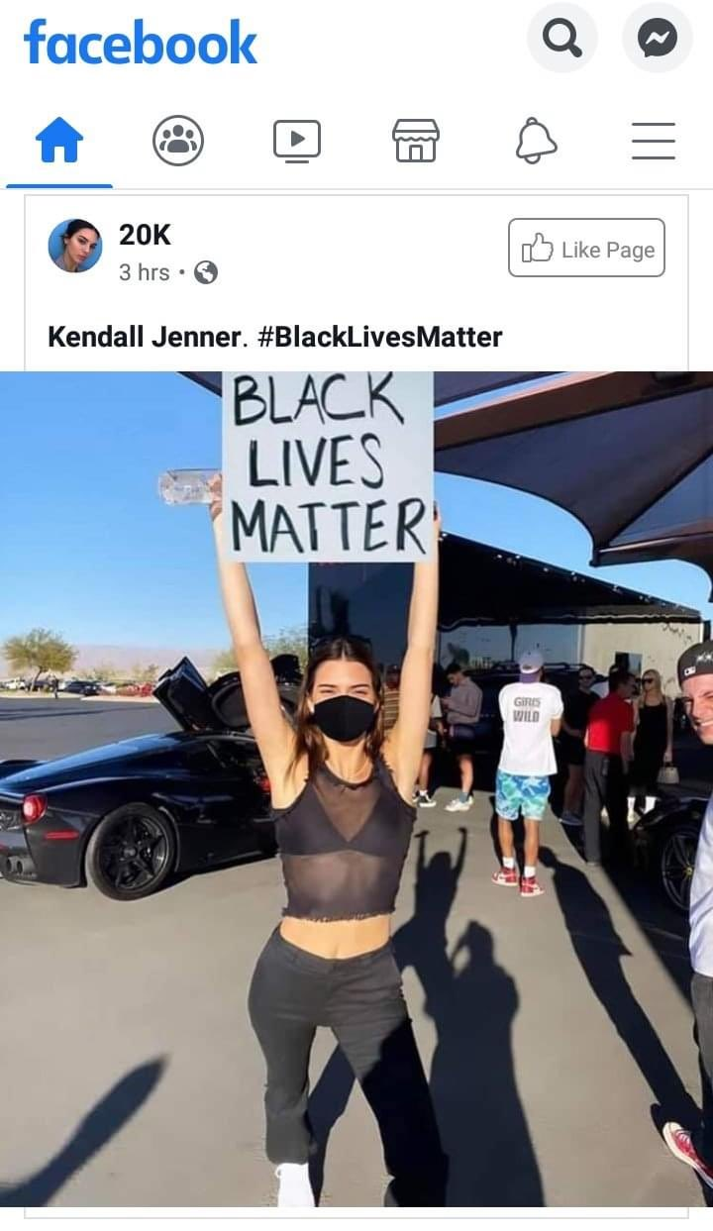
Which is this?

Slide 24
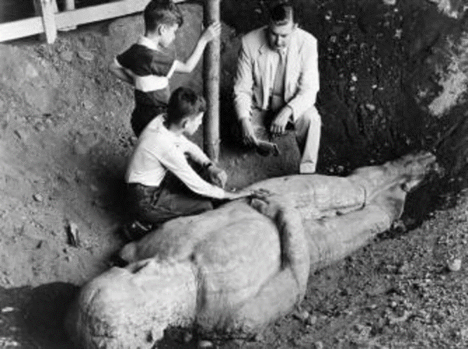
Hoax
A form of disinformation that intends to trick people into believing a false story or event.
Notes:
In 1869, a man named George Hull claimed to have found the petrified remains of a 10-foot tall man. The story made national news, and crowds of people paid money to see the giant. This “giant” was a fake.

Slide 25
Conspiracy Theory
A conspiracy theory is an explanation for an event or situation that invokes a conspiracy by sinister and powerful groups, often political in motivation, when other explanations are more probable.
Conspiracy theories resist falsification and are reinforced by circular reasoning: both evidence against the conspiracy and an absence of evidence for it are re-interpreted as evidence of its truth, whereby the conspiracy becomes a matter of faith rather than something that can be proven or disproven.

Slide 26
Conspiracy Theories
The issue with conspiracy theories and disinformation is that they contain a grain of truth or at least plausibility that makes refuting them far more difficult than defending them (see: Bullshit Asymmetry Principle.)
See: Kennedy Assassination, Pizzagate, MKULTRA, COINTLPRO, etc.

Slide 27
Echo chambers
Polarization and hyper-partisanship
Algorithms used to spread news result in “feedback loop” where you see more of what you already believe…
But studies show that mere exposure to facts or alternate viewpoints does not automatically mean acceptance.

Slide 28
Commonly called “FAKE NEWS”
Made-up or deliberately misleading content – not Trump’s “fake news” epithet, leveled generally at liberal news outlets like CNN, NYT
Two motives: pecuniary ($$ from advertising revenue) and ideological.
In 2016, more fake news was pro-Trump than pro-Clinton (one study: 3x as many pro-Trump articles than pro-Clinton) – generated more ad revenue.

Slide 29
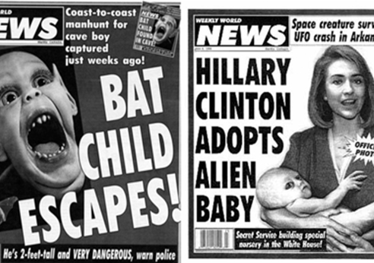

Slide 30
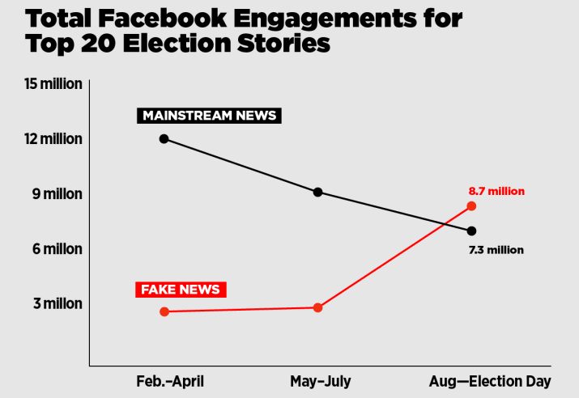

Slide 31
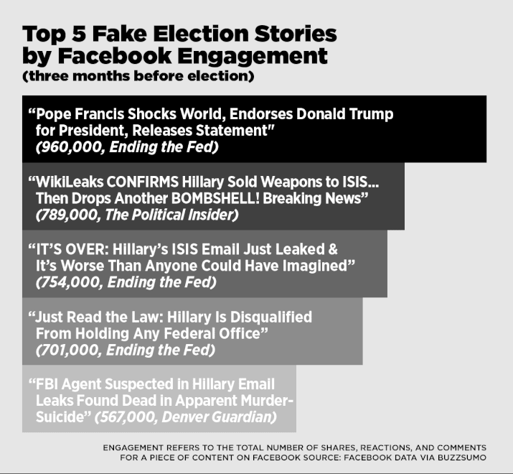

Slide 32
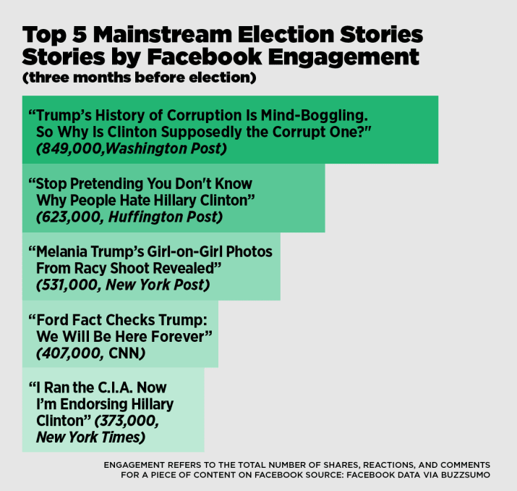


Slide 33
How confusing is fake news?
December 2016 survey by Pew Research Center
64% said fabricated news creates “a lot of confusion”
24% said “some confusion”
Only 11% say “no confusion”
14 percent said they have knowingly shared fake news, 16 percent said they shared something they later realized was fake.
39% “very confident” they can recognize fake news
45% “somewhat confident”
15% said “not very confident” they can tell the difference

Slide 34
Notable Concerns, Part 2
Conversion of popularity into legitimacy
Capture of platforms by undemocratic leaders & bots
Spread of intolerance and hate speech

Slide 35
How we fight
1) Self regulation - (e.g. by Facebook: flagging fake news, working with fact checkers)
2) Changing how algorithms work
3) ”Grievance Redressal Mechanisms” for people harmed by social media
4) Greater transparency about how is being shared

Slide 36
Vertical Reading vs. Lateral Reading
Vertical reading: “staying on the page,” examining the content closely to determine if you think it’s reliable.
Lateral reading: “leaving the page,” examining other sources and analyzing what others have to say.

Slide 37
Examples of Vertical Reading
Checking to see if the site “looks” professional (looking for typos, ads, etc).
Reading the ‘About’ page.
Reading a story closely to see if it is sounds realistic or plausible.

Slide 38
Examples of Lateral Reading
Learn about the reputation of a source.
Checking to see if a story or claim has been reported by multiple reliable sources.
Using the web to trace information, quotes, or images back to the original source.

Slide 39
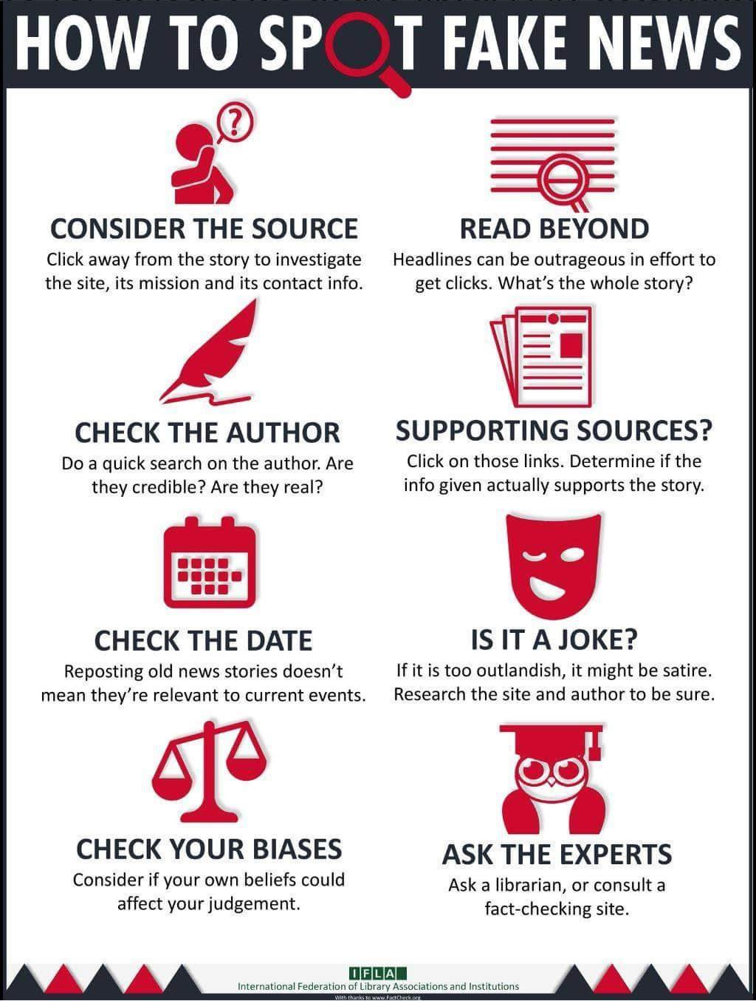
Fake News Video
https://www.cnn.com/videos/cnnmoney/2017/09/12/the-macedonia-story-full-clean-lon-orig.cnn-money

Slide 40
Seeding and echoing
Studies show that disinformation spread in social media can be classified into two broad stages: seeding and echoing. "Seeding," when malicious actors strategically insert deceptions, like fake news, into a social media ecosystem, and "echoing" is when the audience disseminates disinformation argumentatively as their own opinions often by incorporating disinformation into a confrontational fantasy. Studies show four main methods of seeding disinformation:
Selective censorship
Manipulation of search rankings
Hacking and releasing
Directly Sharing Disinformation

Slide 41
Feedback Loops
Research shows that disinformation can be conceptualized as a program that encourages engagement in oppositional fantasies (i.e., culture wars), through which disinformation circulates as rhetorical ammunition for never-ending arguments.
As disinformation entangles with culture wars, identity-driven controversies constitute a vehicle through which disinformation disseminates on social media. This means that disinformation thrives, not despite raucous grudges but because of them. The reason is that controversies provide fertile ground for never-ending debates that solidify points of view.

Slide 42
Feedback Loops
Research on this topic is continuing, and some evidence is less clear. For example, internet access and time spent on social media does not appear correlated with polarization.
Further, misinformation appears not to significantly change political knowledge of those exposed to it.
There seems to be a higher level of diversity of news sources that users are exposed to on Facebook and Twitter than conventional wisdom would dictate, as well as a higher frequency of cross-spectrum discussion.
Other evidence has found that disinformation campaigns rarely succeed in altering the foreign policies of the targeted states.

Slide 43
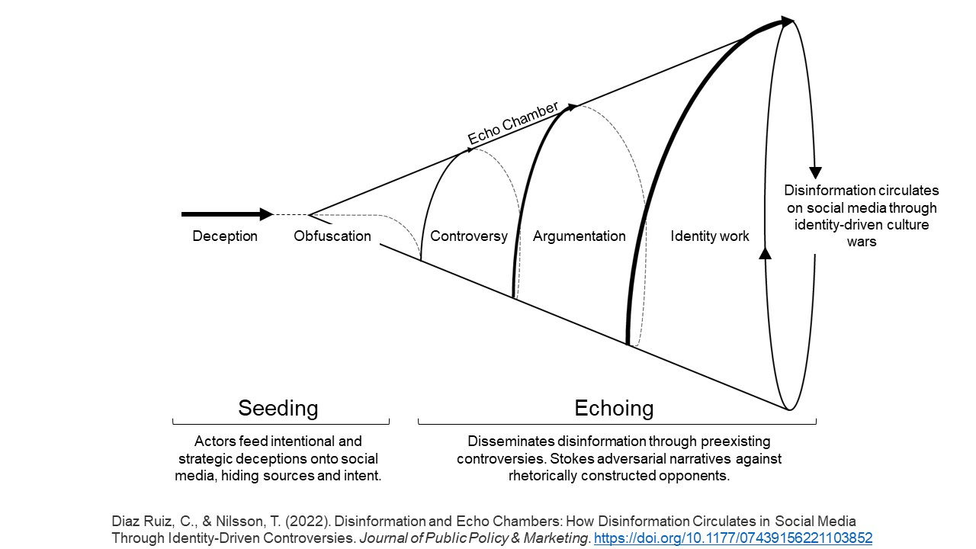

Slide 44
Manipulation techniques
Poisoning the well – Controlling narratives by changing focus to favorable/unfavorable viewpoints. Ex. I own stock in Tesla. I want that stock to go up. I don’t promote Tesla directly. Instead, I support messages that benefit Tesla – climate change articles, dangers of ICE vehicles, stories vilifying the oil industry, etc.

Slide 45
Manipulation techniques
The way other people view material is likely to influence how others view it.
Bandwagoning / Peer-influence– If content is getting a lot of attention (positive or negative) people are more likely to vote (bandwagon) / perceive (peer-influence) the same way.

Slide 46
Manipulation techniques
Manipulated Prevalence – You can make things seem more common or more important than it is by planting multiple stories about it
Uncorrectability – Once information is out there and people see it, they tend to not believe sources that correct or contradict it.
Mere-Exposure – People also tend to prefer and trust things merely because they are familiar with them.

Slide 47
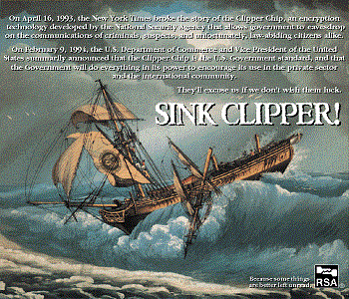
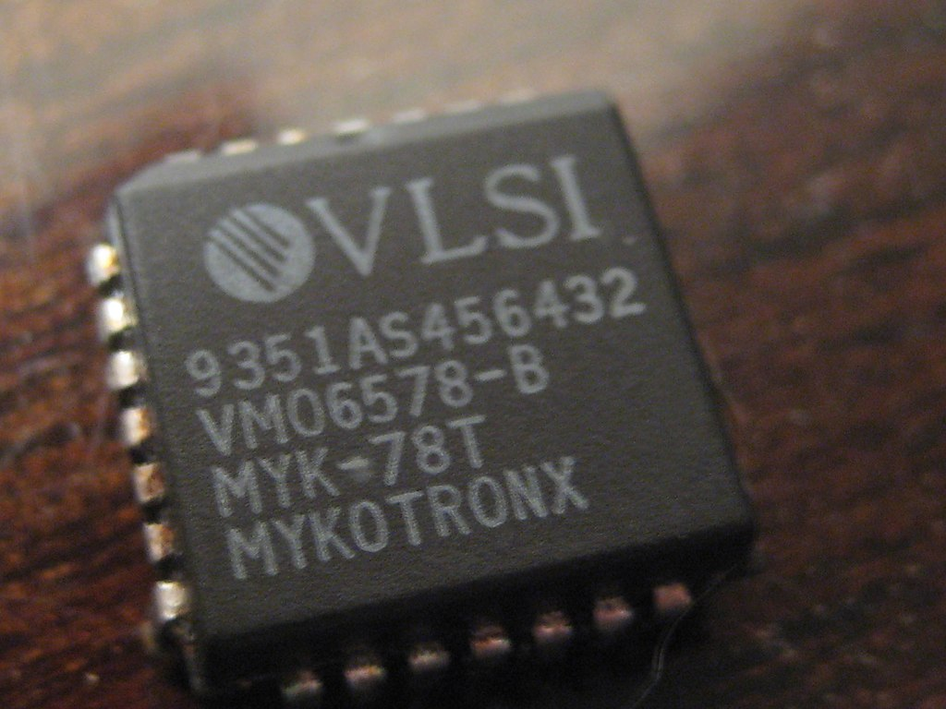

Example of failed manipulation
Notes:
The Clipper chip used a data encryption algorithm called Skipjack^{[1]} to transmit information and the Diffie–Hellman key exchange-algorithm to distribute the cryptokeys between the peers. Skipjack was invented by the National Security Agency of the U.S. Government; this algorithm was initially classified SECRET, which prevented it from being subjected to peer review from the encryption research community. The government did state that it used an 80-bit key, that the algorithm was symmetric, and that it was similar to the DES algorithm.
The Clipper chip was not embraced by consumers or manufacturers and the chip itself was no longer relevant by 1996; the only significant purchaser of phones with the chip was the United States Department of Justice

Slide 48
Shadow brokers - 2016
They published several leaks containing hacking tools, including several zero-day exploits. Specifically, these exploits and vulnerabilities targeted enterprise firewalls, antivirus software, and Microsoft products.
The Shadow Brokers originally attributed the leaks to the Equation Group threat actor, who have been tied to the NSA's Tailored Access Operations unit.
Notes:
On April 14, 2017, the Twitter account used by The Shadow Brokers posted a tweet with a link[22] to the Steem blockchain. Herein, a message with a link to the leak files, encrypted with the password Reeeeeeeeeeeeeee.
The overall content is based around three folders: "oddjob", "swift" and "windows".[23] The fifth leak is suggested to be the "...most damaging release yet"[24] and CNN quoted Matthew Hickey saying, "This is quite possibly the most damaging thing I've seen in the last several years,".[25]
The leak includes, amongst other things, the tools and exploits codenamed: DANDERSPIRITZ, ODDJOB, FUZZBUNCH, DARKPULSAR, ETERNALSYNERGY, ETERNALROMANCE, ETERNALBLUE, EXPLODINGCAN and EWOKFRENZY.[24][26][27]
Some of the exploits targeting the Windows operating system had been patched in a Microsoft Security Bulletin on March 14, 2017, one month before the leak occurred.[28][29] Some speculated that Microsoft may have been tipped off about the release of the exploits.[30]
Eternalblue
Main article: EternalBlue
Over 200,000 machines were infected with tools from this leak within the first two weeks,[31] and in May 2017, the major WannaCry ransomware attack used the ETERNALBLUE exploit on Server Message Block (SMB) to spread itself.[32] The exploit was also used to help carry out the 2017 Petya cyberattack on June 27, 2017.[33]
ETERNALBLUE contains kernel shellcode to load the non-persistent DoublePulsar backdoor.[34] This allows for the installation of the PEDDLECHEAP payload which would then be accessed by the attacker using the DanderSpritz Listening Post (LP) software.[35][36]

Slide 49
Introduction
Cyber Terrorism
Simply, the use of computers to launch a terrorist attack.
Like other forms of terrorism, only the milieu of the attack has changed.
Notes:
Cyber Terrorism, according to the definition of the FBI:
Premeditated, politically motivated attack against information, computer systems, computer programs, and data that results in violence against noncombatant targets by subnational groups or clandestine agents.
Typically, loss of life in a cyber attack would be less than in a bombing attack.

Slide 50
Introduction (cont.)
Significant economic damage
Disruptions to communications
Disruptions in supply lines
General degradation of the national infrastructure
All possible via the Internet
Notes:
All these could lead to significant deaths: train wrecks, hospital deaths, loss of air traffic control resulting in plane crashes, and so forth.

Slide 51
Economic Attacks
Cyber attacks cause economic damage:
Lost files and records
Destroyed data
Stolen credit cards
Money stolen from accounts
Time the IT staff spends cleaning up
Notes:
These cyber attacks are not necessarily terrorist attacks. We have gone over them in past chapters on fraud.
The focus of this chapter is the concerted and deliberate attack against a particular target for the exclusive purpose of causing direct damage.

Slide 52
Economic Attacks (cont.)
Team 1 sets up fake e-commerce sites for a few days:
Harvest credit card numbers, bank account numbers, and so forth
All numbers posted to the Web anonymously on a predetermined date
Notes:
For maximum damage, Team 1 could poison the DNS server to redirect to the bogus sites.

Slide 53
Economic Attacks (cont.)
Team 2 creates a Trojan
Showing business tips or slogans, popular download with business people
Deletes key system files on a certain date

Slide 54
Economic Attacks (cont.)
Team 3 creates a virus.
A DDoS on key financial Web sites, all to take place on the same predetermined date.
Teams 4 and 5 footprint major bank systems.
Team 6 prepares to flood the Internet with false stock tips.
Notes:
What if all these attacks happened on the same predetermined day?
This could cause more damage to our nation than most traditional (bombing) attacks have ever done.
Imagine not one group with six teams, but five groups with six teams, with each group having a trigger date 2 weeks later than the last.

Slide 55
Military Operations Attacks
Attempts to hack into the ultra-secure DoD, CIA, or NSA systems would be met with immediate arrest.
A successful attack on less secure systems could also put our country at risk.
Lower-level security systems that protect the logistics programs
Notes:
These agencies are well protected. But how about lower levels, which can be used by hackers in reconnaissance to glean info for social engineering?

Slide 56
Military Operations Attacks (cont.)
One hack finds that C-141s are routed to a certain base.
Another hack reveals food for 5,000 is delivered to that base.
The final hack shows two brigades have had leaves canceled.
Social engineering puts information together to reveal size and time of a deployment.
Notes:
C-141s are troop transport planes.

Slide 57
Military Operations Attacks (cont.)
Variations on a theme
Hacker changes the date and destination of the food and weapons delivery.
Brigades are now at risk.
Without food and ammunition

Slide 58
Military Operations Attacks (cont.)
Illustrates the need for high security on all military systems.
There are clearly no “low-priority” security systems.
Notes:
Cliff Stoll’s hackers got into U.S. government subcontractors’ systems and used information stored there to gain higher and higher access. They eventually got military secrets that led to the loss of many American lives.

Slide 59
General Attacks
Unfocused attacks with no specific target
Sheer volume of these attacks causes significant economic damage.
IT personnel drop normal projects to combat general attacks.
E-commerce is virtually unusable.
Notes:
A continued series of attacks could cause enough fear in individuals and companies that they would resort to antiquated means to communicate other than the Internet.

Slide 60
Information Warfare
Any attempt to manipulate information in pursuit of a military or political goal:
Use computers to gather information.
Use computers to disseminate propaganda.

Slide 61
Information Warfare (cont.)
Information Control
Since World War ll, part of political and military conflicts
Tokyo Rose
Radio Free Europe
Language manipulation
Innocent civilians killed = collateral damage
Starting a war = preemptive action
Notes:
Propaganda
Since World War ll, part of political and military conflicts
Tokyo Rose in the Orient by the Japanese
Radio Free Europe (RFE) in the cold war by the Allies
Language manipulation
Innocent civilians killed in a bombing = collateral damage
Starting a war = preemptive action
During World War II, a young Japanese-American woman gained notoriety as “Tokyo Rose” for her broadcasts of Japanese propaganda beamed over Radio Tokyo to American troops in the South Pacific.

Slide 62
Information Warfare (cont.)
Information Control
The Internet is an inexpensive vehicle for swaying public opinion
Web sites
Postings to discussion groups and bulletin boards
Public opinion quickly gains momentum
Closely related to propaganda

Slide 63
Information Warfare, cont.
We know how information warfare is done because of the Snowden leaks. Documents show widespread and commonplace data espionage was used all the time to..
Gain the upper hand in negotiations.
Determine if adversaries were being truthful.
Guide policy.

Slide 64

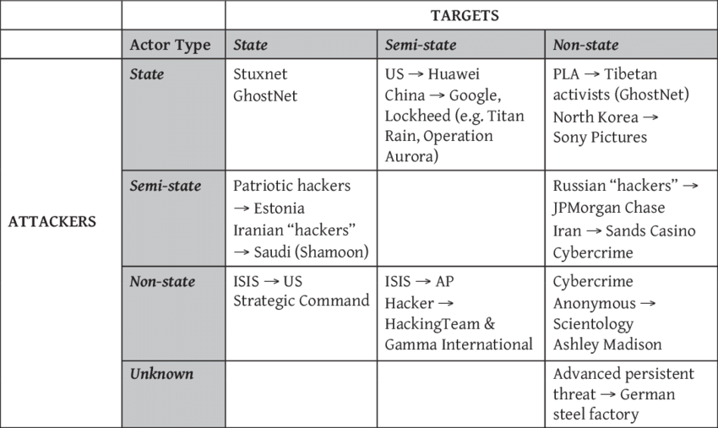

Slide 65
Current Solutions:
Linguistic approaches
Data Representation
Deep Syntax
Semantic Analysis
Rhetorical Structure and Discourse Analysis
Classifers

Slide 66
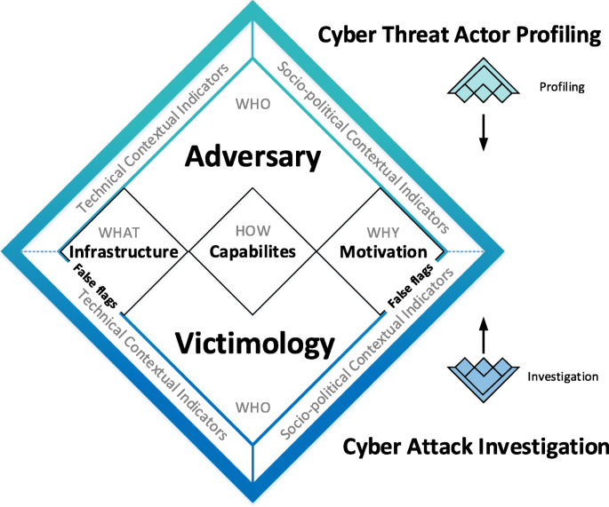

Slide 67
Linguistic Cues to Deception in Online Dating Profiles
Measures:
Emotional linguistic cues:
H1: Fewer self-references ;
More negations and negative emotion words
Effects of media affordances on cues:
H3: Emotionally-related linguistic cues to deception should account for more variance in deception scores than cognitively-related linguistic cues in online dating profiles.
Cognitive linguistic cues:
H2: Fewer exclusive words; Increased motion words;
A lower overall word count
Deception index:
Absolute deviations from the truth were calculated by subtracting observed measurements from profile statements.
Standardize and average the deviations.
2) Accuracy of textual self-descriptions:
Participants rated the accuracy of the self-
description on a scale from 1 to 5.
3) Linguistic measure:
Self-description → Text File → Run through LIWC → Indicate the word frequency for each category

Slide 68
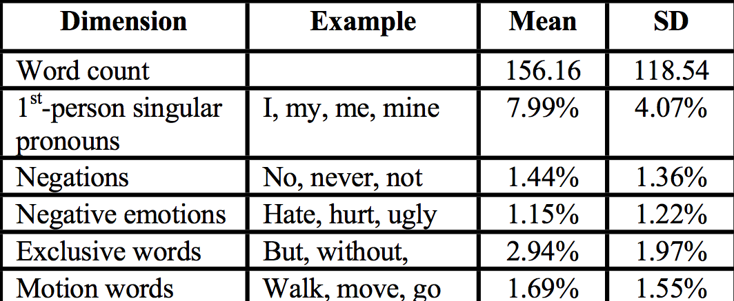
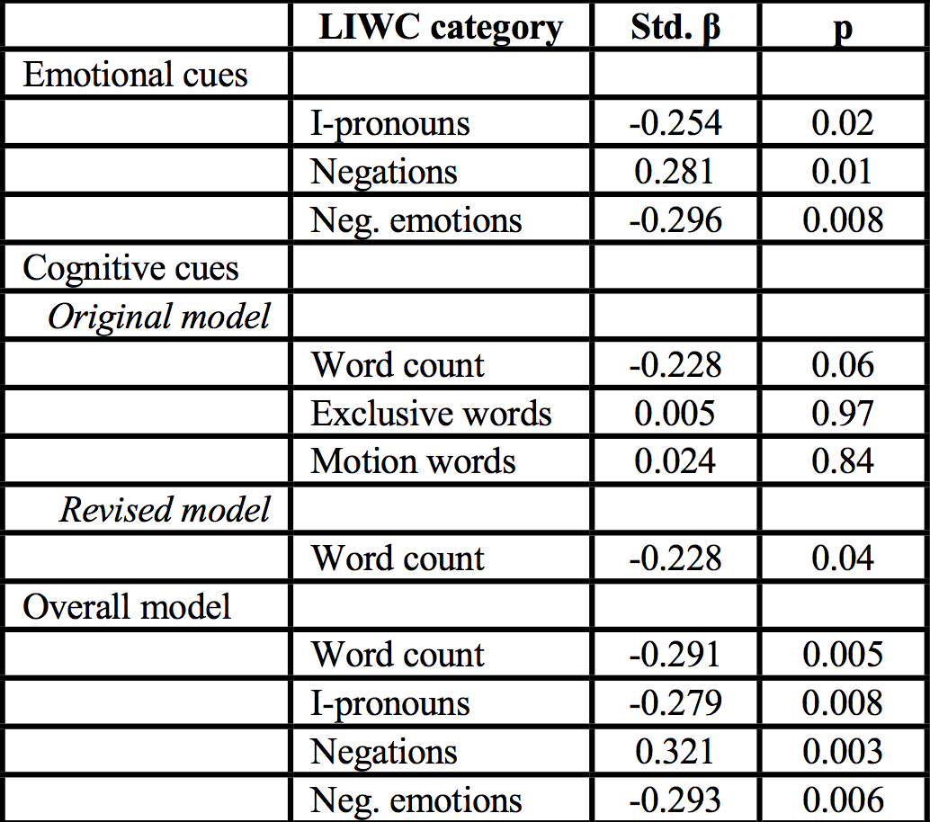
Analysis: Regression model
1) Word Frequency in LIWC:
2) Regression model for linguistic indicators
All of the hypothesized emotional cues were significant predictors of the deception index, but the only reliable cognitive cue was word count.

Slide 69
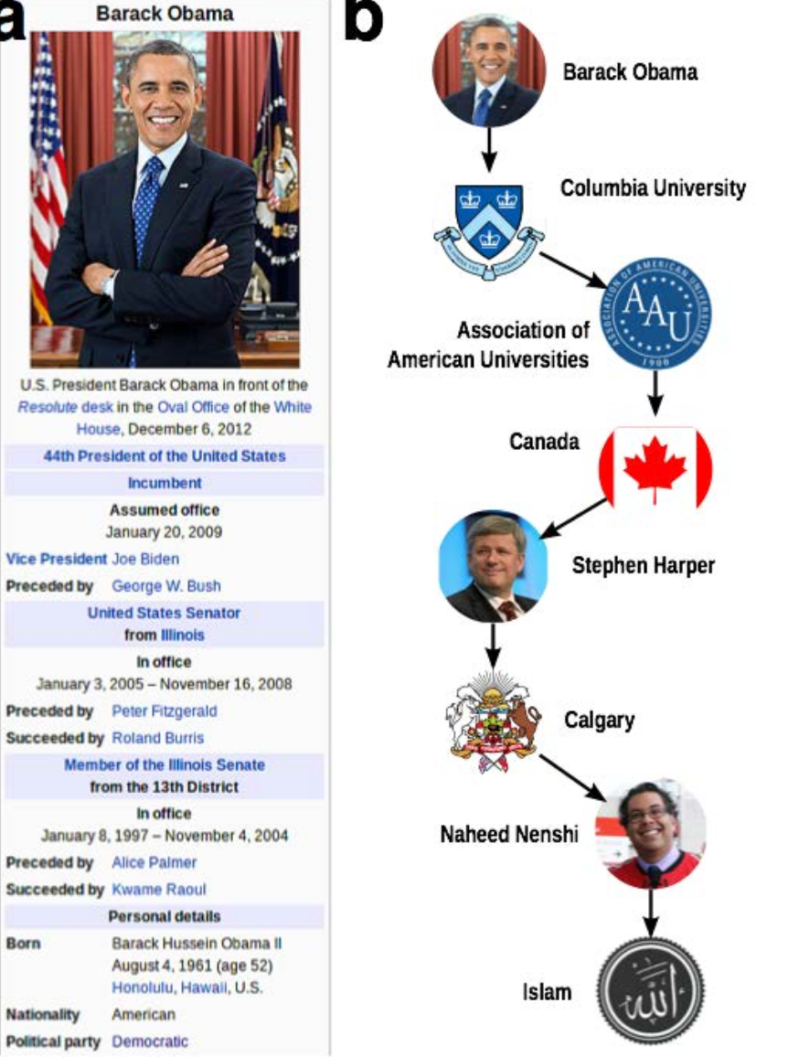
2) Network Approaches:
Linked Data
Fact-checking methods
Leverages an existing body of collective human knowledge
Query existing knowledge network, or publicly available structured data

Slide 70
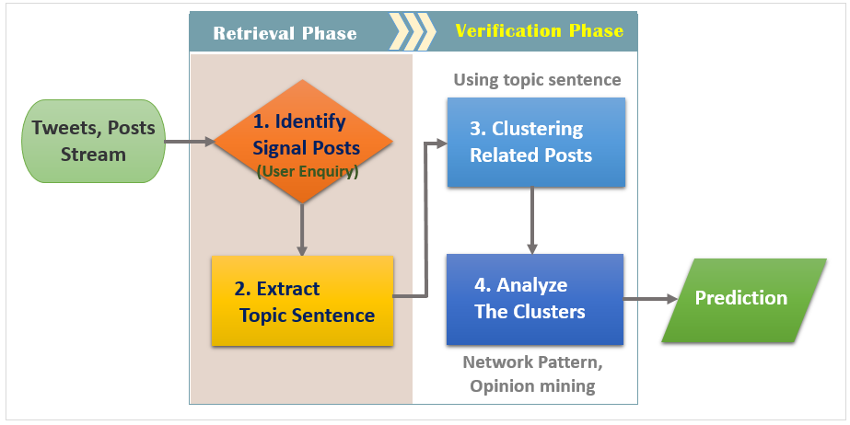

Slide 71
Identifying Signal Posts
The utilization of users’ enquiries and corrections as the signal.
Training a support vector machine (SVM) with the language features and sentiment features.
Language features: the signals can be detected by Natural Language Process (NLP) with a Part-of-Speech (POS) tagging technique for different types of language components.
Sentiment features: modern sentiment classifiers are able to determine positive, negative and neutral sentiments for the writings in social media.

Slide 72
Extracting Topic Sentence
It is inefficient to extract valuable information from a single tweet using NLP because of grammatical complexity and newly coined words.
Most of the rumors spreading out on social networks will have the same or similar contents.
Clustering the signal posts with high similarity

Slide 73
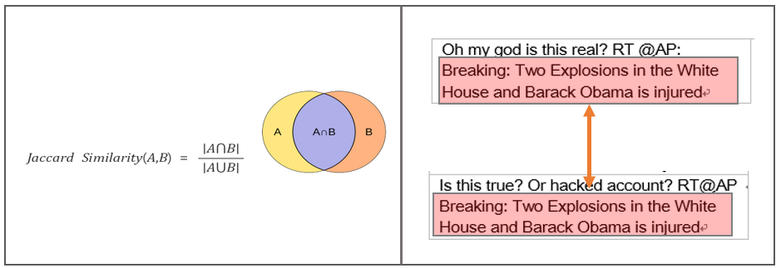
Jaccard Similarity Method
Text Summarization (TS) algorithms like LexRank, which identifies the most important sentence in a set of documents could be used to summarize the main topic from our signal cluster with high accuracy.

Slide 74
Analysis of Cluster
Category | Description
Network features | ∙ Number of fake and bots accounts
Opinion features | ∙ Degrees of positive/negative/sad/anxious/surprised emotion
Timing features | ∙ Numbers of tweets created in given time interval ∙ Ratio of retweets or sharing ∙ The distributions of the interval between two consecutive events

